Slide 1
TDD adoption plan

Slide 2
The goal and how to get there
Goal:
  ATDD and TDD performed in all projects
Strategy:
  One small step at a time
  New projects
    Easy projects first. So, services then UI modules.
    Learn from experience
  Existing non-TDD projects
    Automated unit testing must be completed before TDD can be applied

Slide 3
Plan of the first step
Pilot experiment project
  As plain and simple as possible to be able to focus on the TDD process
  As little dependency on legacy code as possible

Slide 4
Pilot project
Before:
  Some TDD training/refreshing.
  Posters of TDD steps and Refactor guide on the wall.
During:
  Documentation of issues and lessons learned
  Daily meeting to review code, with observers from other teams.
  Pair programming.
After:
  Evaluation and plan for next TDD projects
  Small exam for team members
  Team members spread out to join new TDD projects.

Slide 5
Test automation
Middle-tier modules
  JUnit, test script at app level
Web modules
  Selenium
Android non-UI modules
  JUnit
Android UI modules
  Robotium
iOS non-UI modules ?
iOS UI modules ?
XML? Routing? JSON, Javascript?

Slide 6
Preparation
All developers
  Start preparing as soon as possible, while the pilot project is running:
  Master writing/preparing automated tests using
    Junit / Selenium / Robotium, …
  Complete automated unit tests for existing code.
  Master deriving specific test cases from user story spec.
Someone (who?):
  Learn to verify if a test script covers a certain set of spec (Developer? Team leader? QA personnel?)

Slide 7
Problems anticipated
Easy to follow TDD steps, but not so easy to do a good job at each step
Programmers’ confusion on
  where to start, what to test and what not to test,
  how much to test in one go,
  what to call their tests, and
  how to understand why a test fails.
  A guideline or a how-to doc might be necessary
Not enough emphasis on refactoring.

Slide 8
TDD and ATDD
TDD
Test Driven Development
ATDD
Acceptance Test Driven Development
Each test pins down a technical behavior.
Written by developers
For developers
Run frequently by the team
All tests pass 100% before commit and at integration
Each test pins down a business rule.
Written by the team.
For the team.
Run frequently by the team.
New tests fail until the story is done. Prior tests should all pass.

Slide 9
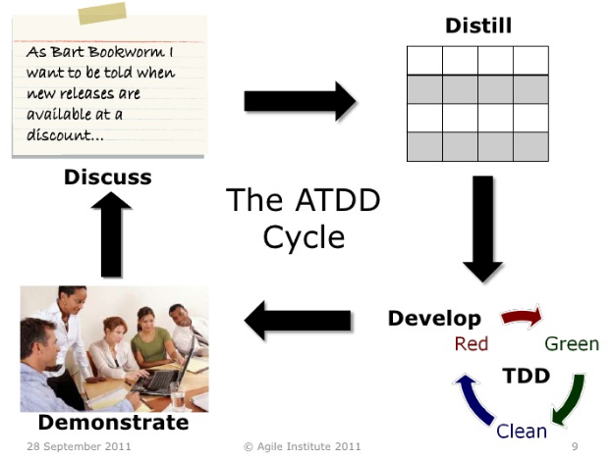

Slide 10
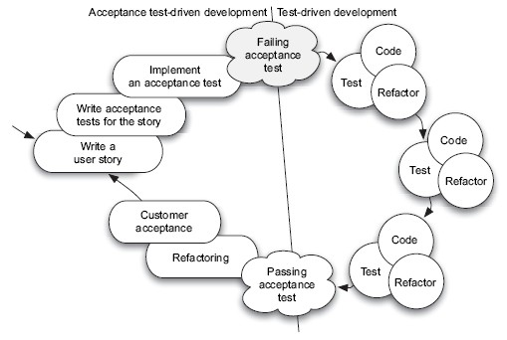
http://www.methodsandtools.com/archive/archive.php?id=72p9

Slide 11


Slide 12


Slide 13
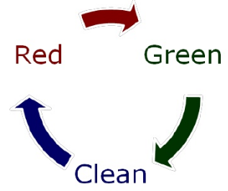
TDD

Slide 14
TDD Steps
Write one unit test.
Build or add to the object under test until everything compiles
Red: Watch the test fail!
Green: Make all the tests pass by changing the object under tests.
Clean: Refactor mercilessly!
Repeat.

Slide 15
BDD - stuff to explore
TDD automatically ensures that no code is not tested.
How to ensure that all functional requirements are included in the tests?
BDD can help?
  The idea:
    http://www.codeproject.com/Articles/148043/Say-Hello-To-Behavior-Driven-Development-BDD-Part
    http://dannorth.net/introducing-bdd/
  Tools with a business readable output
  Tools with a business readable input

